Slide 1




CNN MODEL

Slide 2

Learning Objectives
CNN is supervised learning technique for finding patterns in images to classify and recognize objects, classes and categories. CNN architecture has three layers Convolution layers, Rectified linear unit, and Pooling layers. CNN also use to classify audio, time series and signal data.
GOAL
Source :
www.freepik.com/

Slide 3
Tools and Technology used
CNN is supervised learning technique for finding patterns in images to classify and recognize objects, classes and categories. CNN architecture has three layers Convolution layers, Rectified linear unit, and Pooling layers. CNN also use to classify audio, time series and signal data
convolutional neural network (CNN) is a type of artificial neural network used primarily for image recognition and processing, due to its ability to recognize patterns in images.

Slide 4
Methodology
The methodology for a Convolutional Neural Network (CNN) model for image classification involves breaking down images into smaller pieces to identify patterns. These patterns help the CNN recognize objects, such as shapes and edges.
Steps in the CNN model methodology
Import libraries: Import libraries like TensorFlow
Set up directory structure: Create a directory structure for the image data
Create image data generators: Create generators to flow data from directories
Train the CNN model: Train the CNN model using the image data
Evaluate the model: Evaluate the performance of the CNN model
CNN model architecture
Convolutional layer: Applies filters to the input image to capture local patterns
Activation layer: Introduces non-linearity using activation functions like ReLU
Pooling layer: Reduces spatial dimensions while retaining important information
Dense layer: Also known as a fully connected layer
CNN model advantages
CNNs are inspired by how animals process visual information to recognize objects
CNNs are efficient because they use the same filters across different parts of an image
CNNs are a popular method for image classification

Slide 5
The problem statement for a CNN model for image classification is to build a model that can classify images based on their content

Slide 6
Solution:
CNN methods in image processing involve using convolutional layers to detect features, pooling layers to downsample data, and fully connected layers for classification. Activation functions add non-linearity, optimization algorithms adjust parameters, and regularization techniques prevent overfitting

Slide 7
Algorithm:
Step 1: Download the Dataset
Import the kagglehub library.
Download the dataset techsash/waste-classification-data using kagglehub.dataset_download().
Print the dataset path.
Step 2: Import Required Libraries
Import necessary Python libraries such as:
numpy for numerical operations.
streamlit for UI development.
pandas for handling data.
matplotlib.pyplot for visualization.
cv2 for image processing.
tqdm for progress bar visualization.
tensorflow.keras for building a deep learning model.
Step 3: Define Paths to Dataset
Set train_path and test_path to point to dataset directories:
/root/.cache/kagglehub/datasets/techsash/waste-classification-data/versions/1/DATASET/TRAIN
/root/.cache/kagglehub/datasets/techsash/waste-classification-data/versions/1/DATASET/TEST

Slide 8
Step 4: Load and Process Images
Initialize two empty lists: x_data (for images) and y_data (for labels).
Iterate over each category in train_path:
Read image files in each category.
Convert each image to RGB format using cv2.cvtColor().
Append image data to x_data and corresponding category label to y_data.
Create a Pandas DataFrame data to store images and labels.
Step 5: Visualize Data Distribution
Use plt.pie() to plot the label distribution.
Use plt.figure() and plt.subplot() to display a few random images with their corresponding labels.
Step 6: Define and Build CNN Model
Initialize a Sequential model.
Add the following convolutional layers:
First layer: 32 filters, (3×3) kernel, ReLU activation, MaxPooling.
Second layer: 64 filters, (3×3) kernel, ReLU activation, MaxPooling.
Third layer: 128 filters, (3×3) kernel, ReLU activation, MaxPooling.
Flatten the output.

Slide 9
Add fully connected layers:
Dense layer with 256 neurons, ReLU activation, dropout (0.5).
Dense layer with 64 neurons, ReLU activation, dropout (0.5).
Output layer with 2 neurons, Sigmoid activation.
Compile the model using:
binary_crossentropy loss.
adam optimizer.
accuracy as a metric.
Display model summary using model.summary().
Step 7: Data Augmentation for Training
Use ImageDataGenerator to apply rescaling (1./255) to images.
Define train_generator and test_generator:
Load images from train_path and test_path.
Resize images to (224, 224).
Use batch size of 64.
Set color mode to RGB.
Use categorical class mode

Slide 10
Step 8: Train the CNN Model
Train the model using model.fit(), passing:
train_generator for training.
15 epochs.
test_generator for validation.
Store the training history in hist.
Step 9: Plot Accuracy and Loss Curves
Plot training and validation accuracy using plt.plot().
Plot training and validation loss using plt.plot().
Step 10: Define Prediction Function
Create function predict_fun(img):
Display input image.
Resize it to (224, 224).
Reshape image for model input.
Predict class using model.predict(img).
Print whether the image is Recyclable Waste or Organic Waste.

Slide 11
Step 11: Save the Model
Save trained model as "waste_classifier.h5".
Step 12: Test Model on New Images
Load test images veg.jpg and pls.jpg using cv2.imread().
Call predict_fun() to classify images.

Slide 12
Code:
import kagglehub
path = kagglehub.dataset_download("techsash/waste-classification-data")
print("Path to dataset files:", path)
# Importing necessary libraries
import numpy as np
import streamlit as st
import sigstore
import pandas as pd
import matplotlib.pyplot as plt
import cv2
from tqdm import tqdm
import warnings
warnings.filterwarnings('ignore')
train_path = "/root/.cache/kagglehub/datasets/techsash/waste-classification-data/versions/1/DATASET/TRAIN"
test_path = "/root/.cache/kagglehub/datasets/techsash/waste-classification-data/versions/1/DATASET/TEST"
# Importing Libraries
from tensorflow.keras.models import Sequential
from tensorflow.keras.layers import Conv2D, MaxPooling2D, Activation, Dropout, Flatten, Dense, BatchNormalization
from tensorflow.keras.preprocessing.image import ImageDataGenerator, img_to_array, load_img
from tensorflow.keras.utils import plot_model
from glob import glob

Slide 13
# Visualization
from cv2 import cvtColor
x_data = []
y_data = []
for category in glob(train_path+'/*'):
for file in tqdm(glob(category+'/*')):
img_array = cv2.imread(file)
img_array = cv2.cvtColor(img_array, cv2.COLOR_BGR2RGB)
x_data.append(img_array)
y_data.append(category.split('/')[-1])
data = pd.DataFrame({'image':x_data, 'label':y_data})
data.shape
colors = ['#a0d157', '#c48bb8']
plt.pie(data.label.value_counts(), labels=['Organic', 'Recyclable'], autopct='%0.2f%%',
colors = colors, startangle = 90, explode=[0.05, 0.05])
plt.show()
plt.figure(figsize=(20, 15))
for i in range(9):
plt.subplot(4, 3,(i%12)+1)
index = np.random.randint(15000)
plt.title('This is of {0}'.format(data.label[index]))
plt.imshow(data.image[index])
plt.tight_layout()

Slide 14
model = Sequential()
model.add(Conv2D(32, (3, 3), input_shape=(224, 224, 3)))
model.add(Activation('relu'))
model.add(MaxPooling2D())
model.add(Conv2D(64, (3, 3)))
model.add(Activation('relu'))
model.add(MaxPooling2D())
model.add(Conv2D(128, (3, 3)))
model.add(Activation('relu'))
model.add(MaxPooling2D())
model.add(Flatten())
model.add(Dense(256))
model.add(Activation('relu'))
model.add(Dropout(0.5))
model.add(Dense(64))
model.add(Activation('relu'))
model.add(Dropout(0.5))
model.add(Dense(2))
model.add(Activation('sigmoid'))
model.compile(loss = "binary_crossentropy",
optimizer = "adam",
metrics = ["accuracy"])
batch_size = 64
model.summary()

Slide 15
train_datagen = ImageDataGenerator(rescale = 1./255)
test_datagen = ImageDataGenerator(rescale=1./255)
train_generator = train_datagen.flow_from_directory(
train_path,
target_size = (224, 224),
batch_size = batch_size,
color_mode = "rgb",
class_mode = "categorical")
test_generator = test_datagen.flow_from_directory(
test_path,
target_size = (224, 224),
batch_size = batch_size,
color_mode = "rgb",
class_mode = "categorical")
hist = model.fit(
train_generator,
epochs=15,
validation_data=test_generator)
plt.figure(figsize=(10,6))
plt.plot(hist.history['accuracy'], label='Train Accuracy')
plt.plot(hist.history['val_accuracy'], label=' Validation Accuracy')
plt.legend()
plt.show()

Slide 16
plt.figure(figsize=(10,6))
plt.plot(hist.history['loss'], label='Training Loss')
plt.plot(hist.history['val_loss'], label='Validation Loss')
plt.legend()
plt.show()
def predict_fun(img):
plt.figure(figsize=(6, 4))
plt.imshow(cv2.cvtColor(img, cv2.COLOR_BGR2RGB))
plt.tight_layout()
img = cv2.resize(img, (224, 224))
img = np.reshape(img, [-1, 224, 224, 3])
result = np.argmax(model.predict(img))
if result == 0:
print('The image shown is Recyclable Waste')
elif result == 1:
print('The image shown is Organic Waste')
# Save the trained model
model.save("waste_classifier.h5")
test_img = cv2.imread('/content/veg.jpg')
predict_fun(test_img)
test_img = cv2.imread('/content/pls.jpg')
predict_fun(test_img)
# Save the trained model
model.save("waste_classifier.h5")

Slide 17
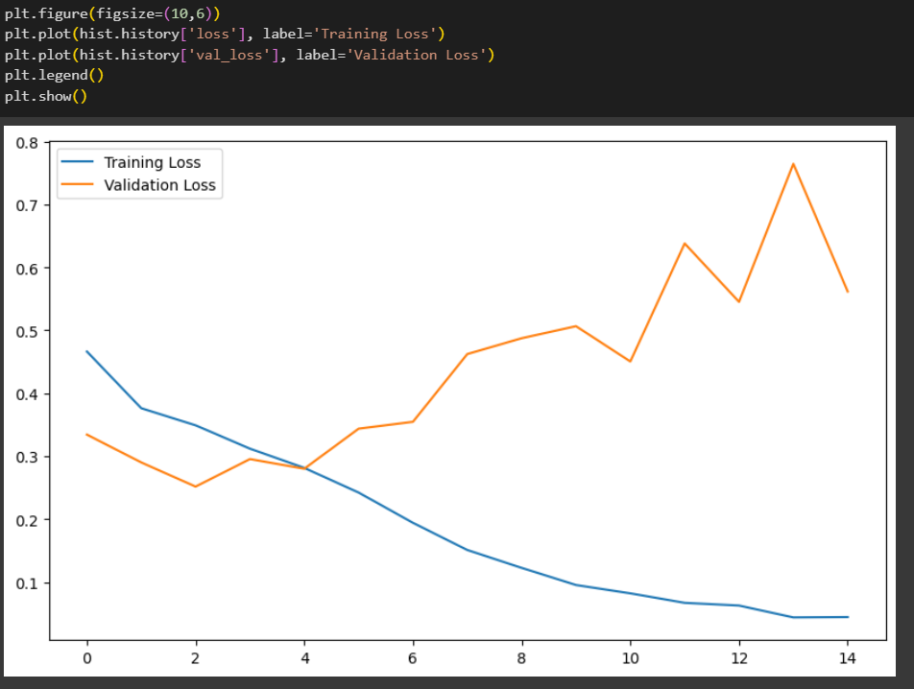
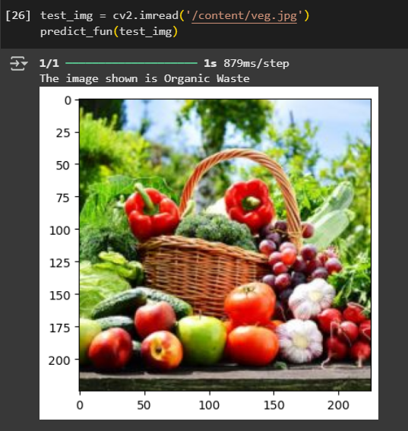
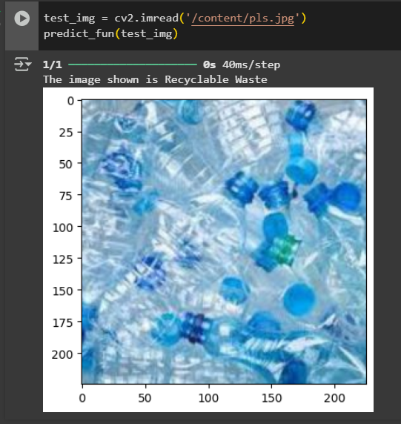
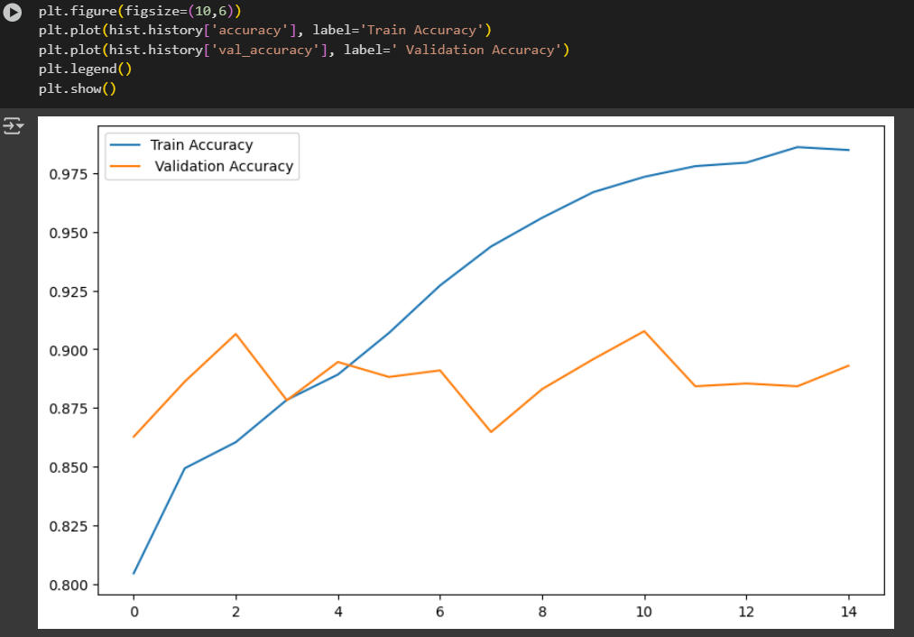
Output Screenshot:

Slide 18
Conclusion:
Convolutional neural networks (CNNs) are a powerful tool for image classification that can accurately identify objects in images. CNNs can automatically learn and extract complex features, and are used in many applications.
Conclusion
CNNs have revolutionized computer vision and can be used in many applications.
CNNs can be used for object recognition, medical image analysis, facial recognition, and art generation.
CNNs can be improved by balancing complexity with regularization techniques to avoid overfitting.
CNNs can be improved by adding more input layers and hidden neurons.
CNNs can be improved by using attention mechanisms, architectural innovations, and self-supervised learning

